Slide 1
Advanced bibliometric analysis in the context of research evaluation: Area Based Connectedness (ABC) to society
Ed Noyons
AESIS Methods & Instruments for Assessing the Societal Impact of Research,
King’s College London, Nov 6-8, 2019

Slide 2
Baseline
Monitoring Non-scientific impacts of actors by
Area-Based Connectedness (ABC) to society
Data:
Web of Science (CWTS version)
Publication level classification
Altmetrics data

Slide 3
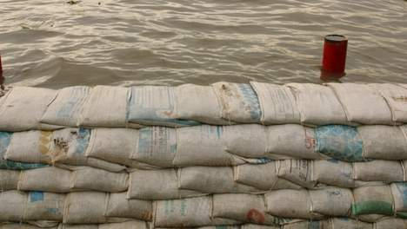
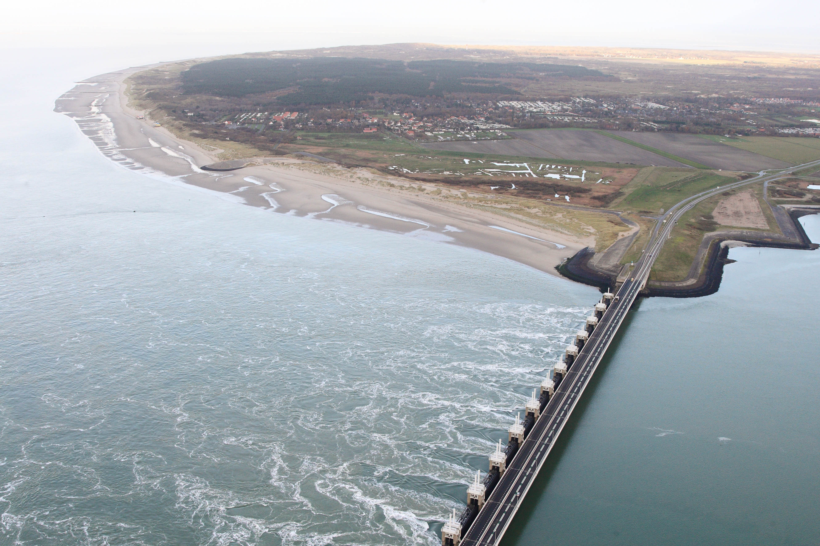

Key assumptions
Societal impact too diverse and complicated to assess in a ‘traditional’ quantitative way;
Societal connectedness may be a more productive approach;
Connectedness (same as societal impact) is not a merit of one actor only. It is a credit of a community/ research area.
Which one is more important?

Slide 4
How to measure connectedness of research?
Academic output connected to society;
Through signals between research outputs and society;
Signals from both sides;
Each signal represents a certain link/ connection/ interaction,
a dimension of connectedness.

Slide 5
Signals and dimensions
Signal | Dimension
Papers (co-)authored by industry | Industry R&D
Papers published in local languages | Local interest or focus
Papers cited by patents | Technological or commercial interest
Papers mentioned on twitter (or other social media) | Link to general public
Papers mentioned in policy documents | Relating to political issues
Papers mentioned in news | Link to general public
… | …

Slide 6
How to use these signals:
Area-based connectedness

Slide 7
About the communities/ research areas?
Research is a collaborative effort;
It’s the community that has impact/ is connected, not the individual actor (sandbag);
Therefore, we should measure the interactions at the level of research areas (“walls of sandbags”);
How to define “walls of sandbags for flood defense”?

Slide 8
Research areas (communities)

Slide 9
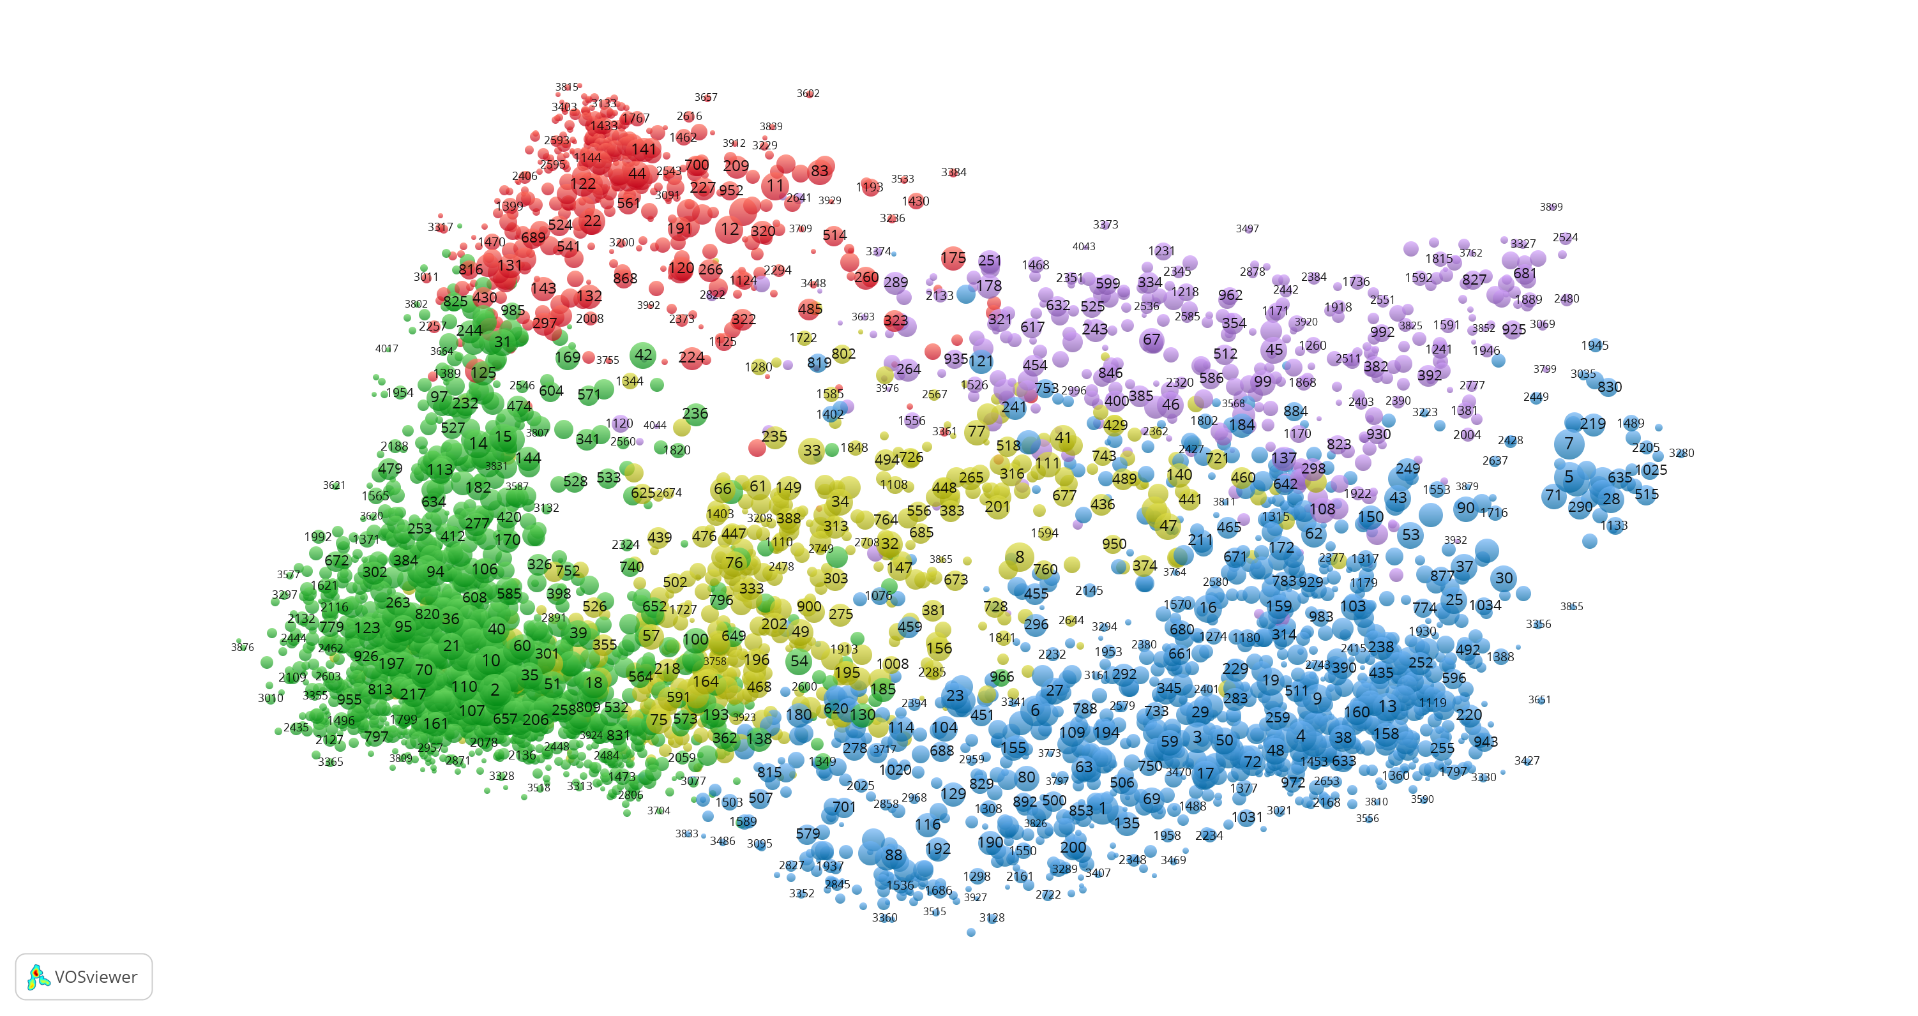
Consider the WoS science landscape
(publication based classification, 4000 clusters, areas)
Social Sci & Hum.
Maths & CompSci
Life & Earth
Biomedical & Health
Physical Sci & Engin.

Slide 10
About each research area, we know:
All info covered by its publications
(journals, authors, affiliations, keywords, etc);
Total volume (number of P whole period);
Volume per year (trend);
Other average stats (n authors, refs, affiliations, share International collaboration, …);
Impact (overall and per year)
Interdisciplinarity?
Internal coverage (proxy for database coverage)
…

Slide 11
What else do we know about each cluster/area?
The percentage of papers P (co-authored) by industry;
The percentage of papers not published in English;
The percentage of papers being cited by patents;
The percentage of papers being tweeted;
The percentage of papers mentioned in news items;
The percentage of papers mentioned in policy documents;
…

Slide 12
Some statistics (2014-2017) for signals
Dimension | Average WoS overall | Max value in an area
Policy | 0.47% | 19%
News | 3.80% | 49%
Industry R&D | 4.53% | 30%
Technology (cited by patents) | 4.27% | 41%
Non-English | 2.99% | 83%

Slide 13
Back to the WoS science landscape
(publication based classification, 4000 clusters)
Social Sci & Hum.
Maths & CompSci
Life & Earth
Biomedical & Health
Physical Sci & Engin.

Slide 14
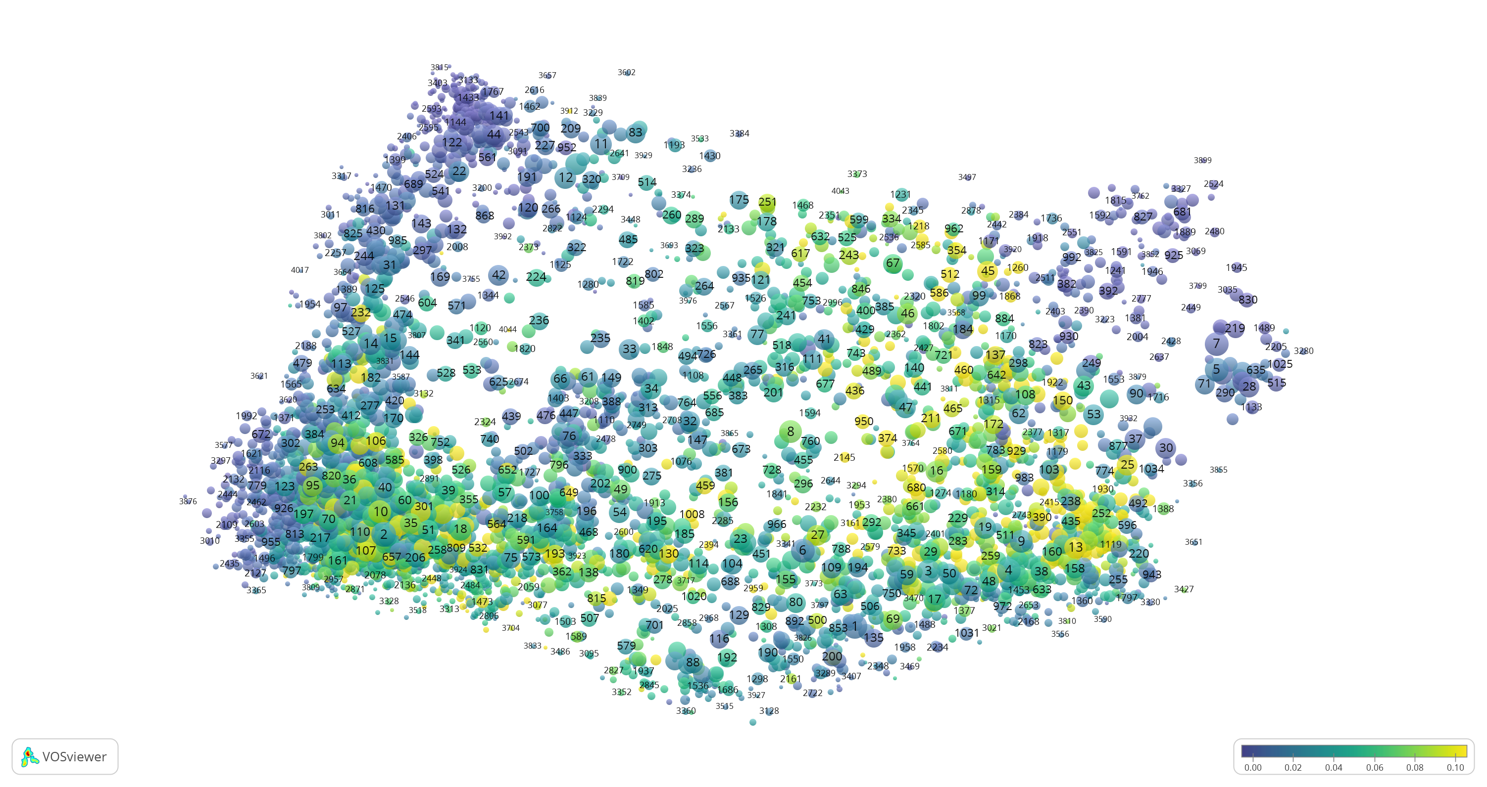
Share (co-)authored by industry
Social Sci & Hum.
Maths & CompSci
Life & Earth
Biomedical & Health
Physical Sci & Engin.
Notes:
Pharma
Chips, wireless communication, communication networks
Coal, petroleum
Medical Statistics

Slide 15
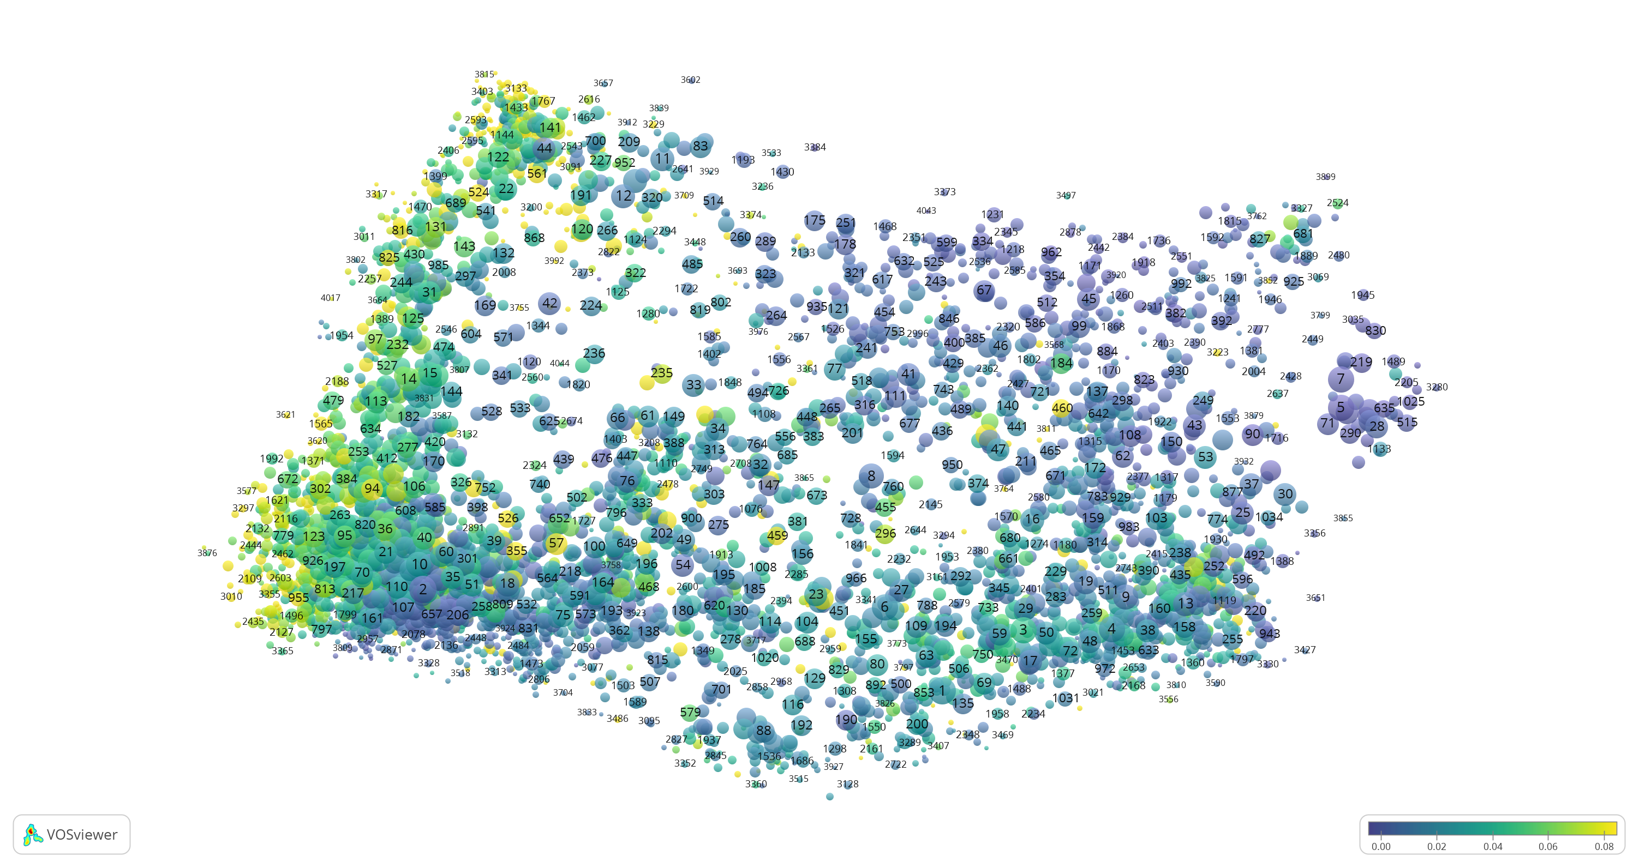
Share of papers not in English
Social Sci & Hum.
Maths & CompSci
Life & Earth
Biomedical & Health
Physical Sci & Engin.
Notes:
Social sciences
Clinical research
Health
tropical

Slide 16
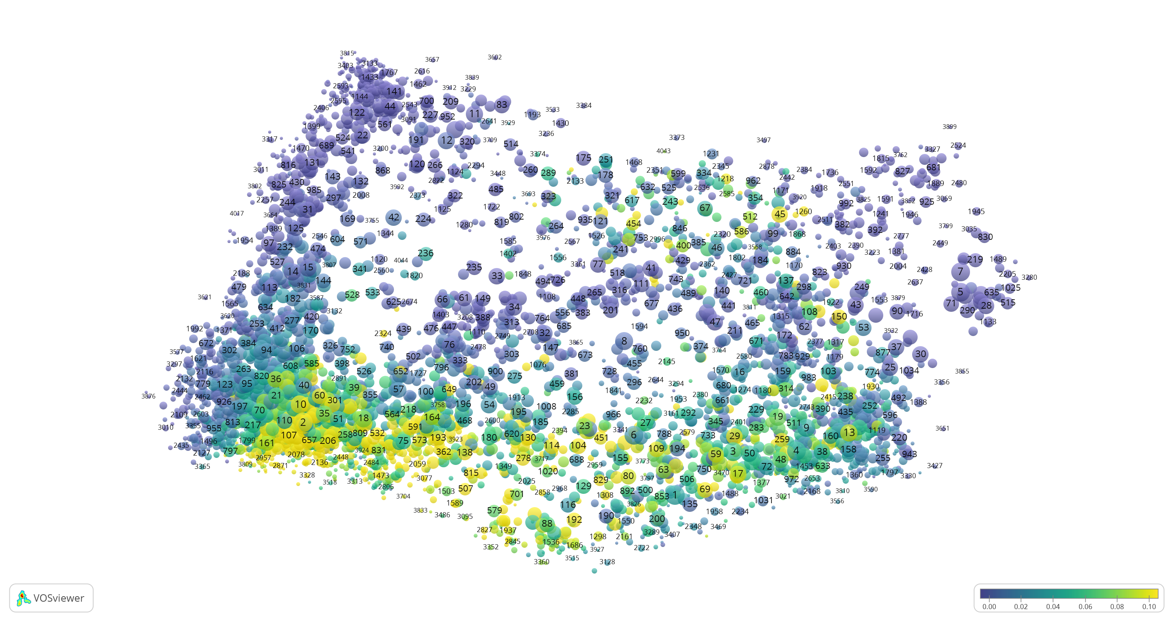
Share of papers cited by patents
Social Sci & Hum.
Maths & CompSci
Life & Earth
Biomedical & Health
Physical Sci & Engin.
Notes:
Drug related research
Applied physics
Wireless communication
Computer science
Smart city, smart grid

Slide 17
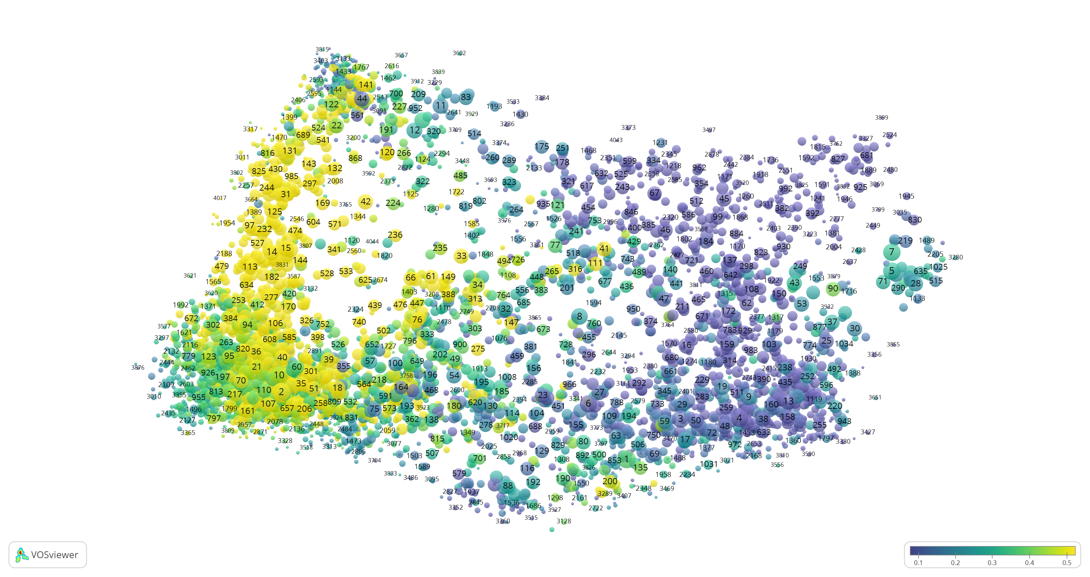
Share of papers mentioned on Twitter
Social Sci & Hum.
Maths & CompSci
Life & Earth
Biomedical & Health
Physical Sci & Engin.
Notes:
Social sciences
Health
ecology

Slide 18
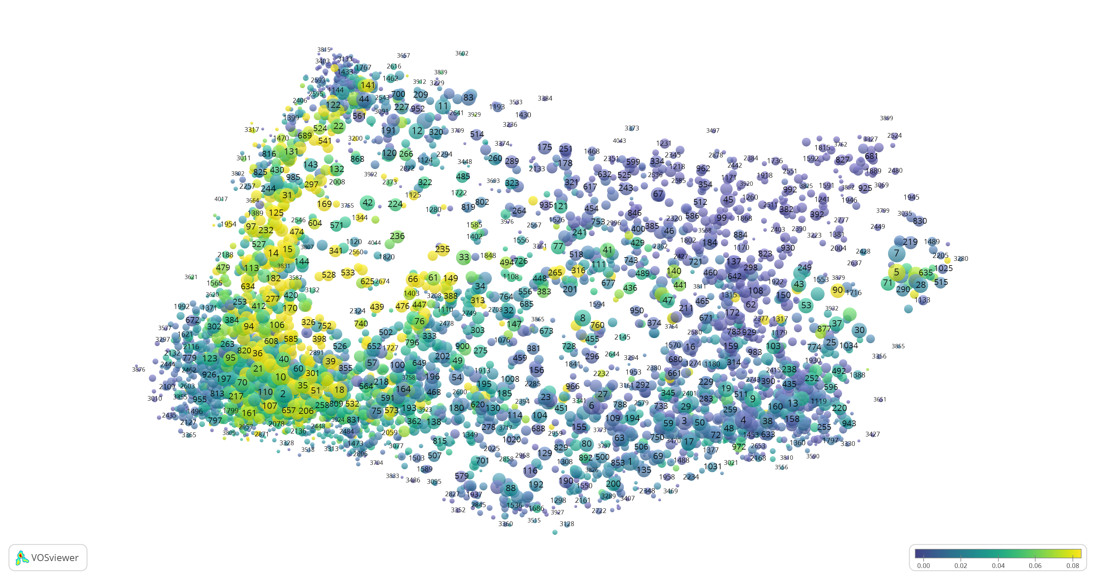
Share of papers mentioned in News
Social Sci & Hum.
Maths & CompSci
Life & Earth
Biomedical & Health
Physical Sci & Engin.
Notes:
Social sciences
Health
Life & earth, climate

Slide 19
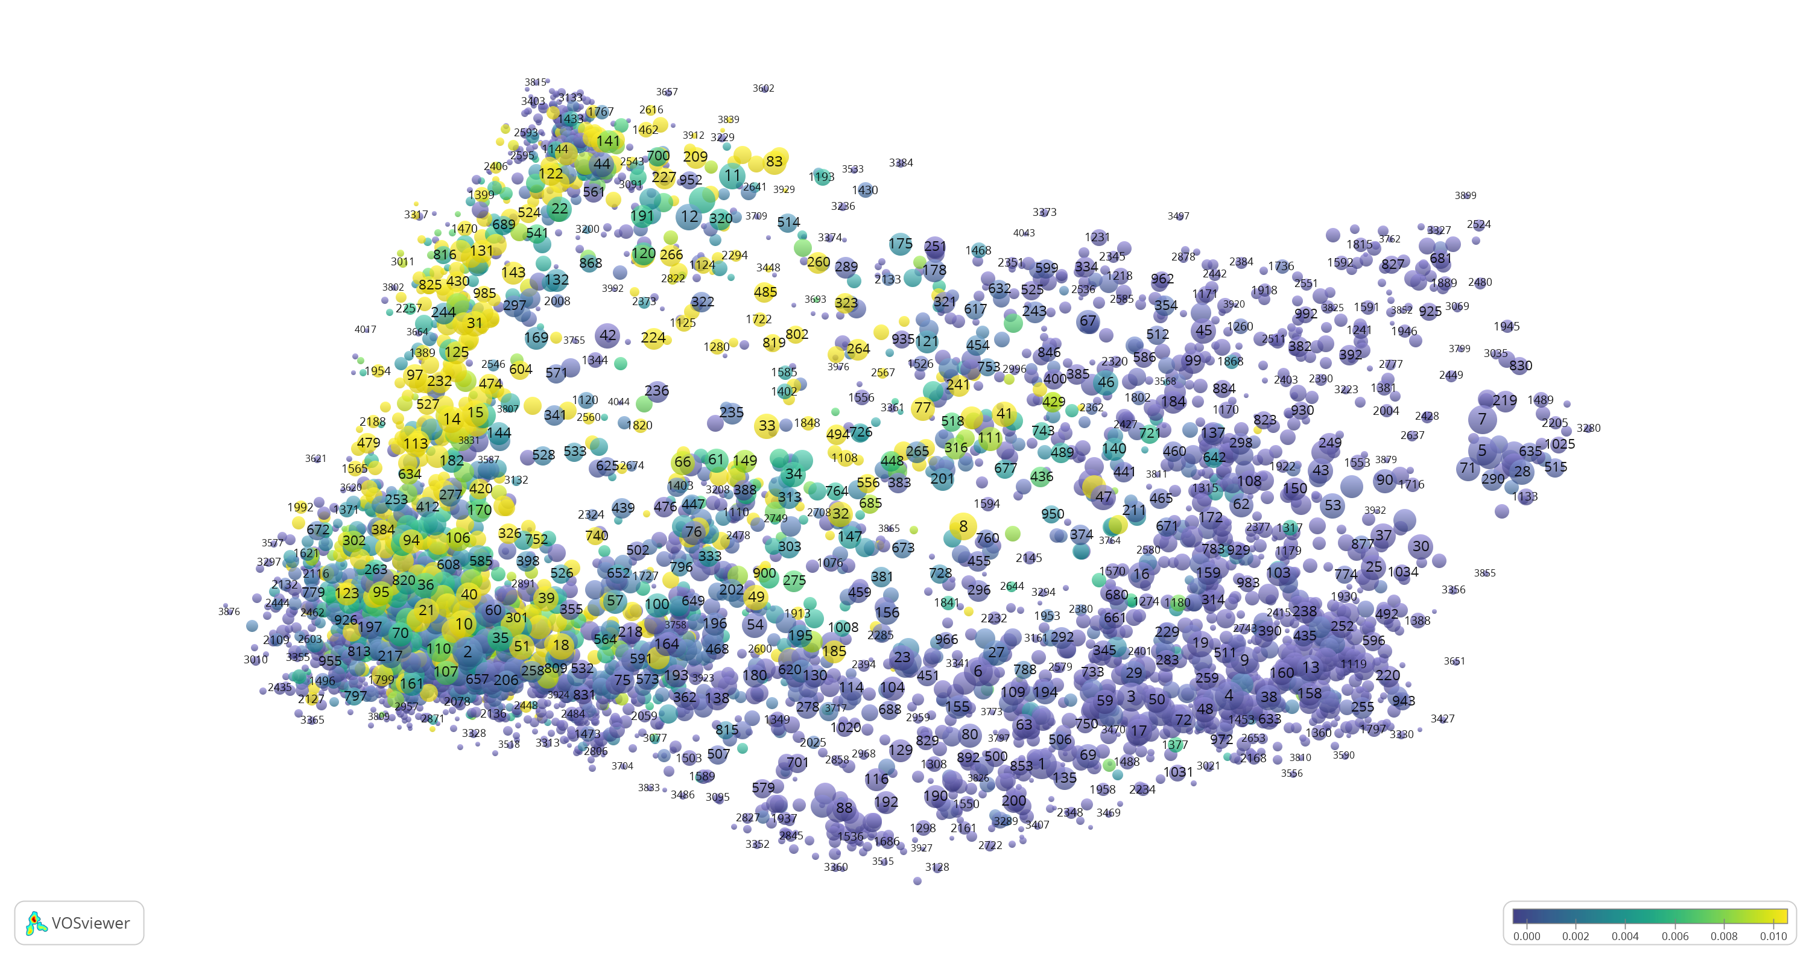
Share of papers mentioned in policy documents
Social Sci & Hum.
Maths & CompSci
Life & Earth
Biomedical & Health
Physical Sci & Engin.
Notes:
Social sciences
Health
Climate
environmental

Slide 20
In practice:
A case study a Faculty of Science

Slide 21
Faculty has 8 institutes
Institute of Environmental Sciences
Institute of Biology
Center for Drug Research
Institute of Advanced Computer Science
Institute of Chemistry
Institute of Physics
Mathematical Institute
Observatory

Slide 22
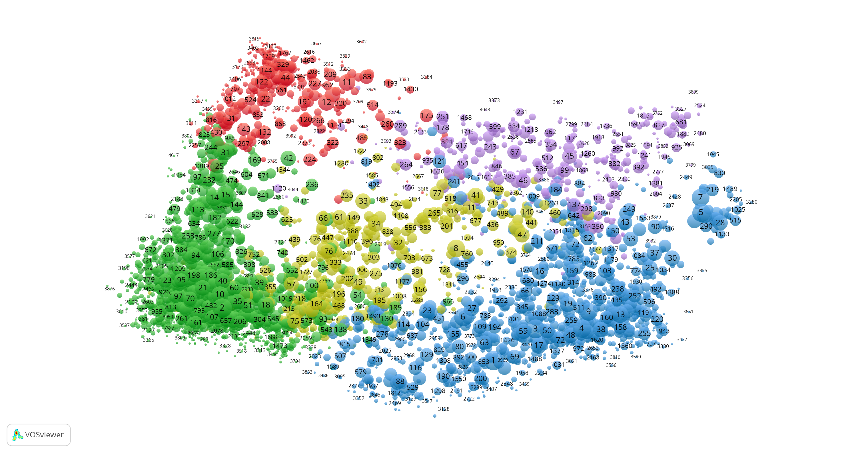
Institute of Environmental Sciences (CML)

Slide 23
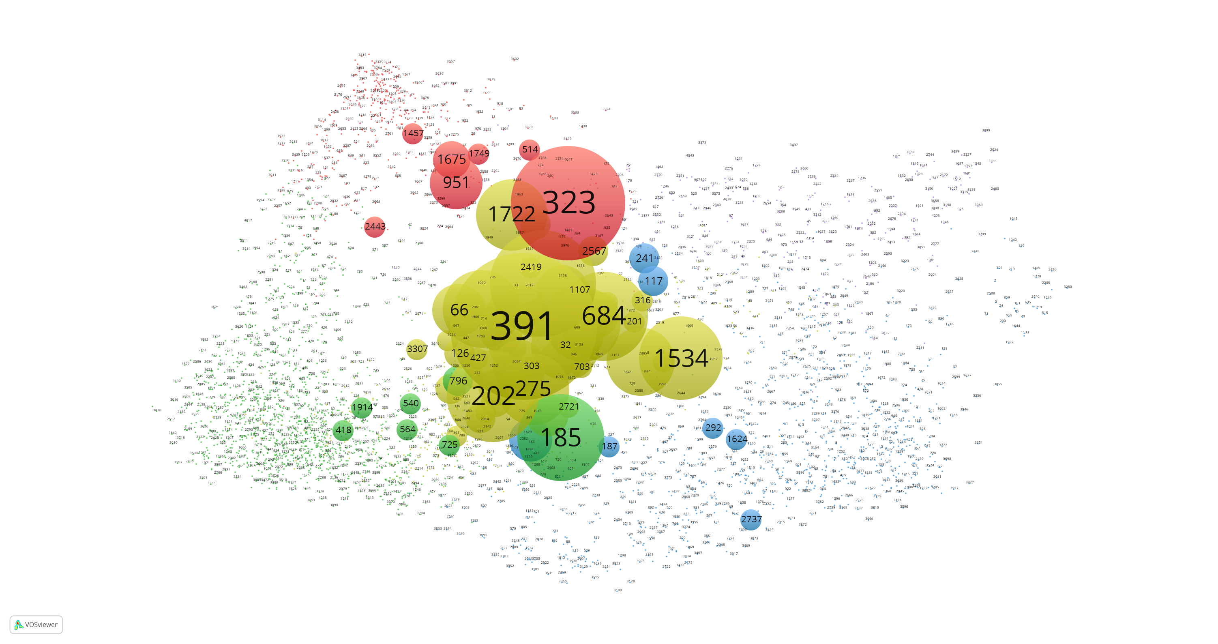
Institute of Environmental Sciences (CML) within the entire landscape
323 - environmental kuznets curve;
economic growth;
urbanization;
electricity consumption;
391 - clonal integration;
facilitation;
clonal plant;
specific leaf area;
leaf trait;

Slide 24
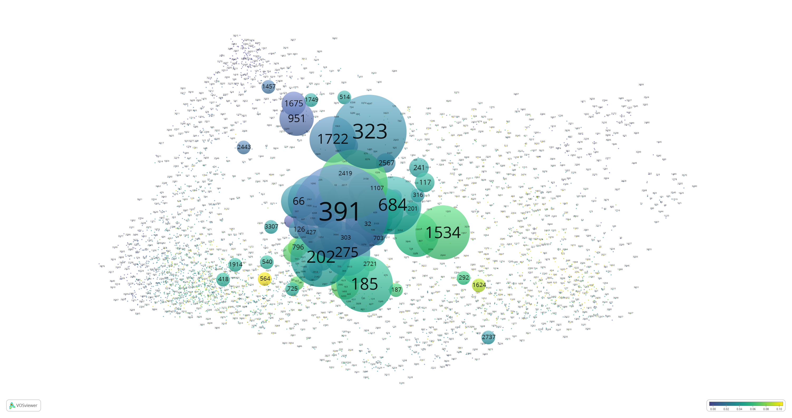
Institute of Environmental Sciences (CML) output characterized by ABC(industry)
323 - environmental kuznets curve;
economic growth;
urbanization;
electricity consumption;
391 - clonal integration;
facilitation;
clonal plant;
specific leaf area;
leaf trait;

Slide 25
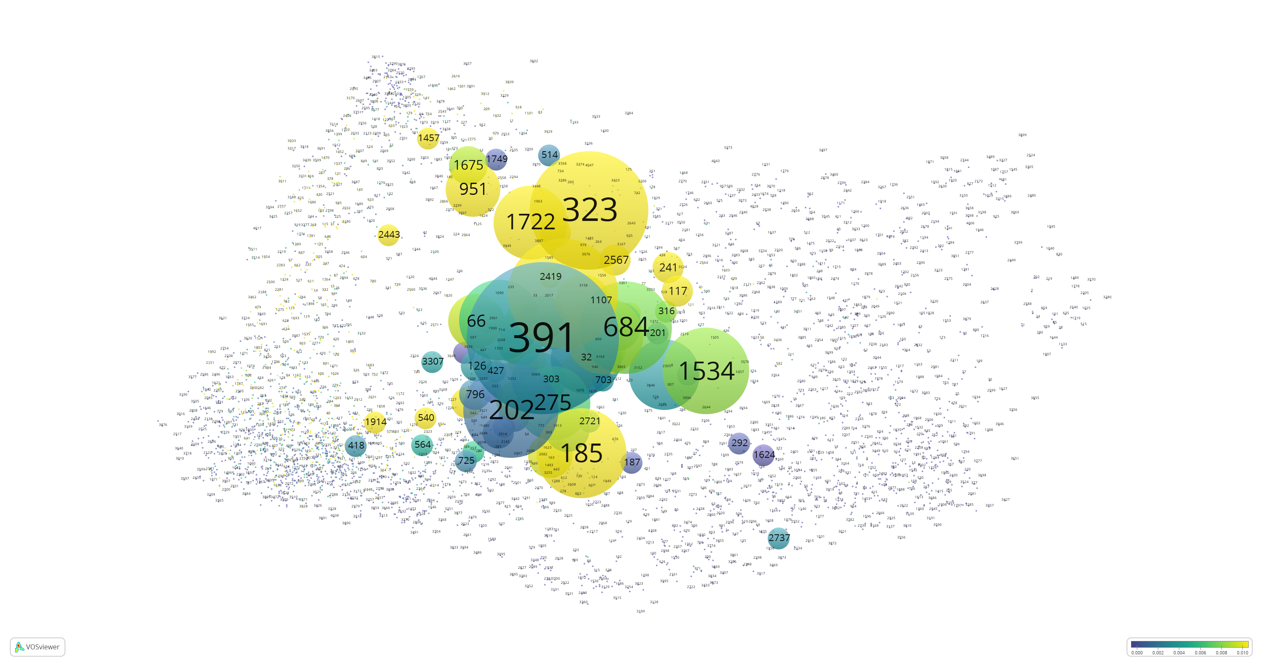
Institute of Environmental Sciences (CML) output characterized by ABC(policy)
323 - environmental kuznets curve;
economic growth;
urbanization;
electricity consumption;
391 - clonal integration;
facilitation;
clonal plant;
specific leaf area;
leaf trait;
185 - titanium dioxide nanoparticle;
genotoxicity; oxidative stress;
exposure;
daphnia magna;

Slide 26
Area-based vs actor-based
Actor-based: share of papers from actor A mentioned in policy docs
Area-based: output of actor A, characterized by the area Z in which A is active (inherited from Z)

Slide 27
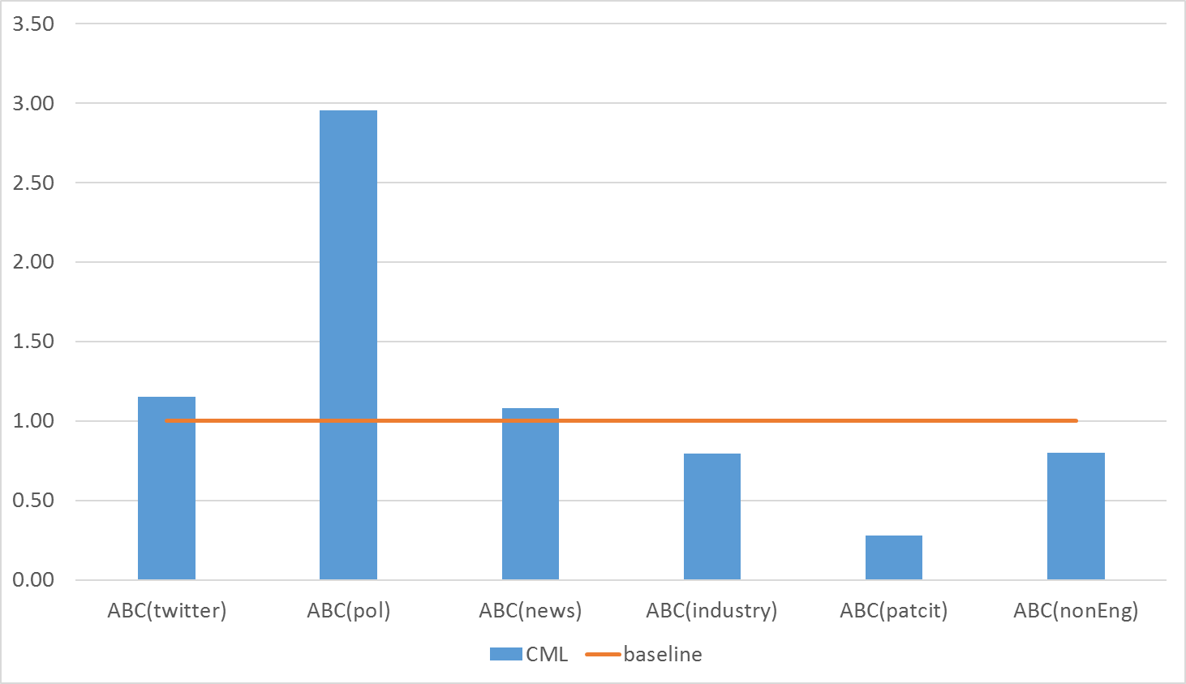
ABC profile of Institute of Environmental Sciences (CML)

Slide 28
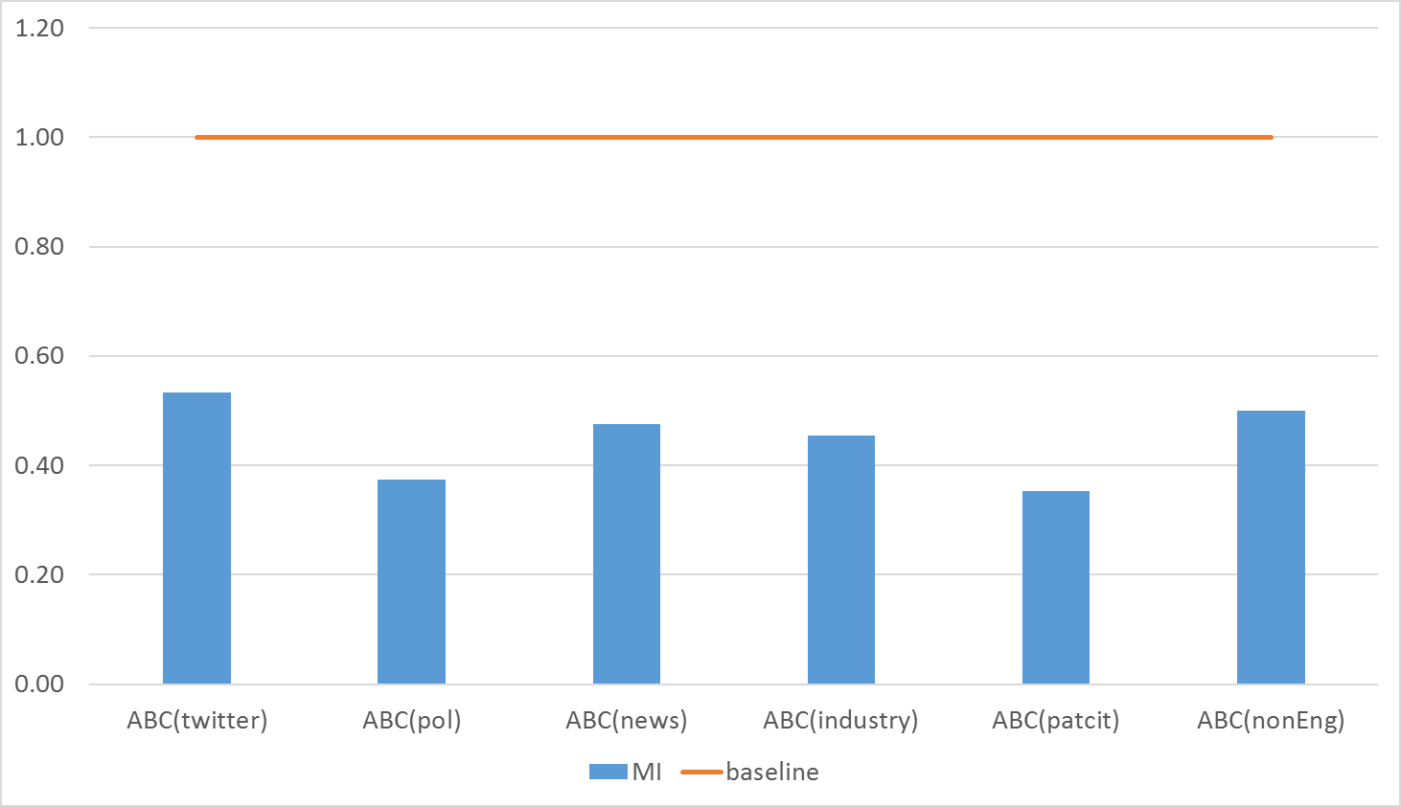
ABC profile of Mathematical Institute

Slide 29
Take away
Altmetric data and other non-scholarly data provide a productive facility to monitor non-scientific ’impacts' of science actors using Area-Based Connectedness (ABC) to society;
The ABC approach
  Measures connectedness to society at the level of communities rather than the individual actors within;
  Attributes more credit to content;
  Is less vulnerable to manipulation and gaming.

Slide 30
End

